Slide 1
PatBaSe Pattern-based Quantification & Clustering of Anomalous Curves in qPCR Vijay B. Reddy GTS Analytics Team

Slide 2
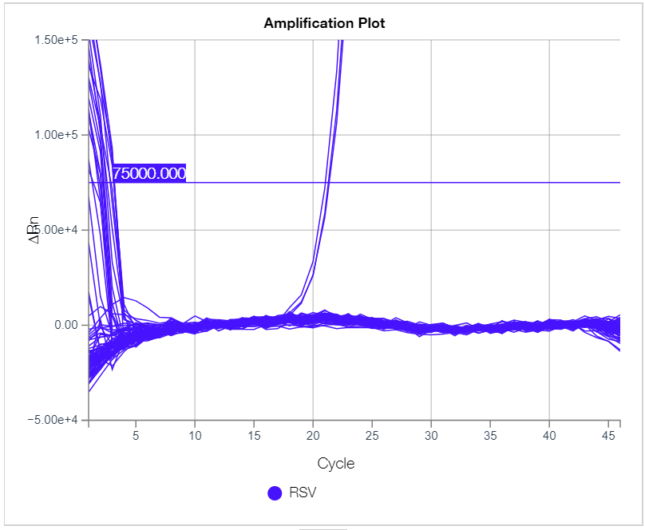
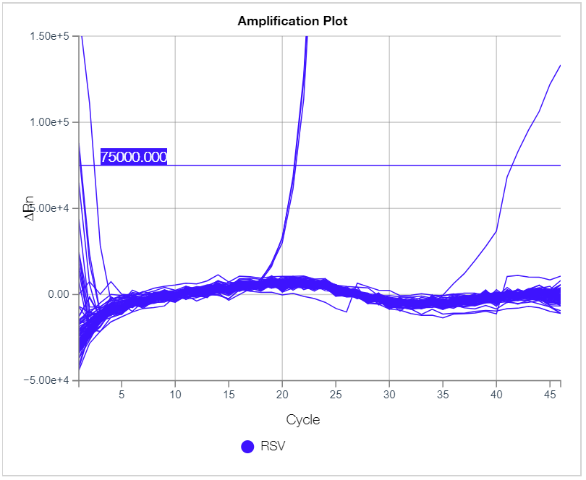
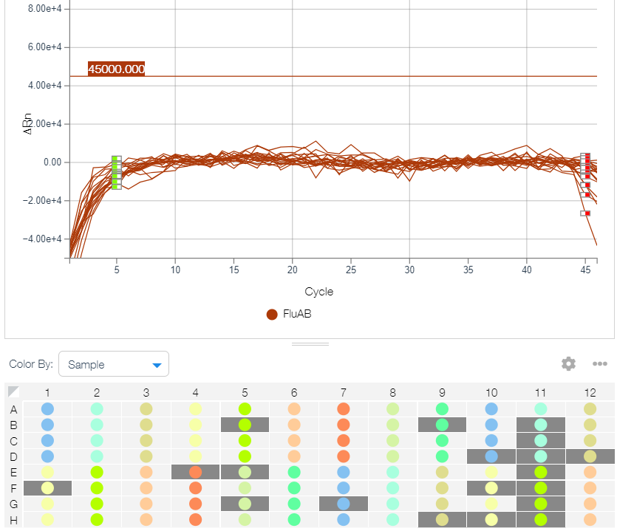
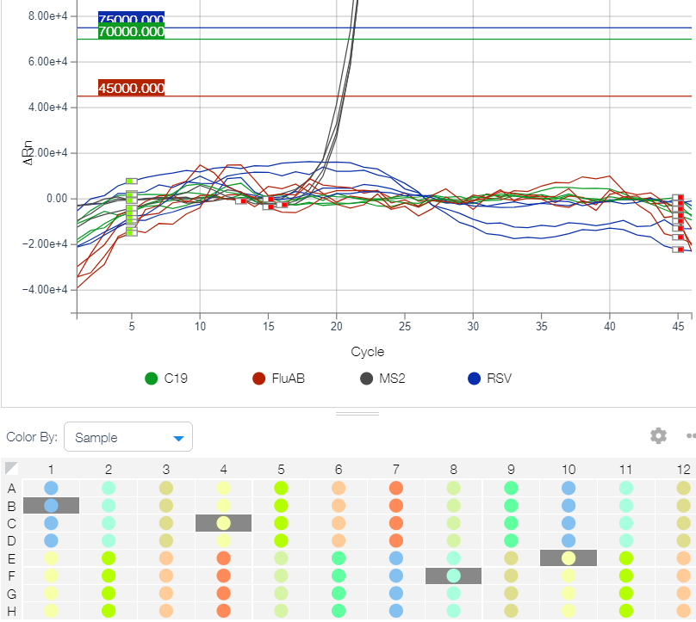
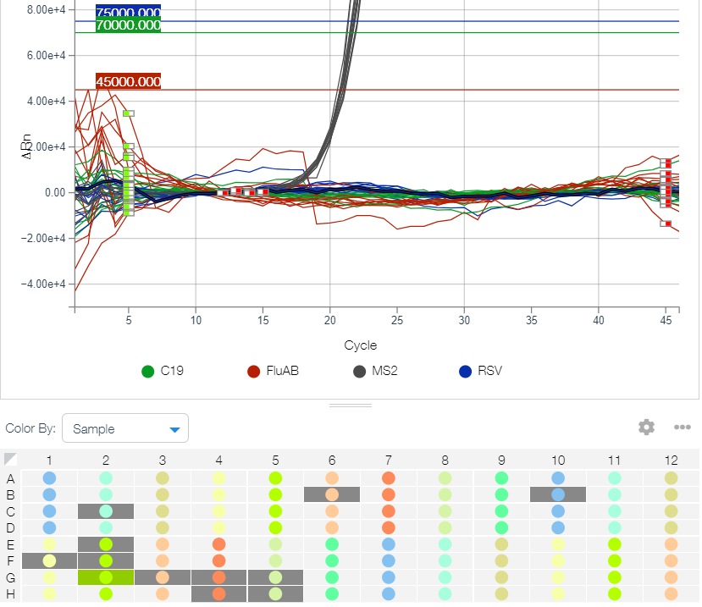
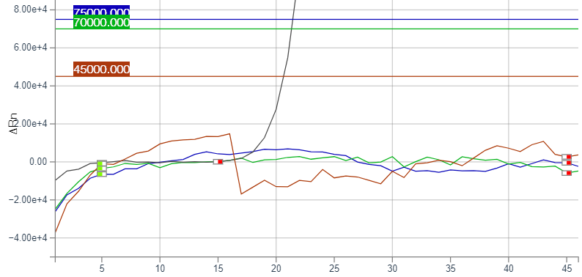
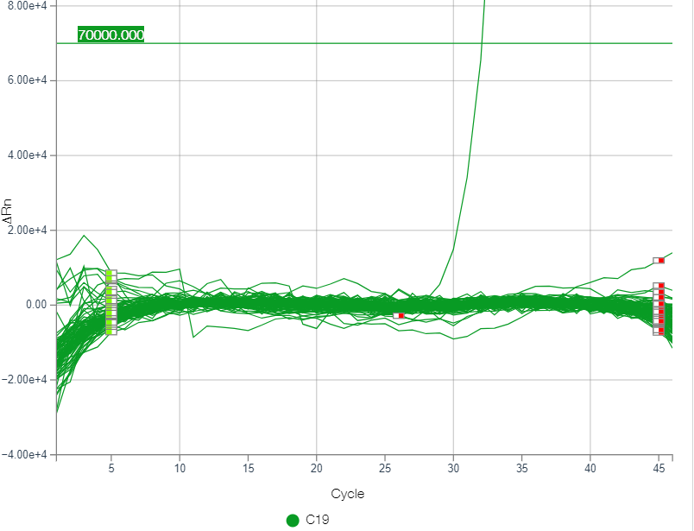
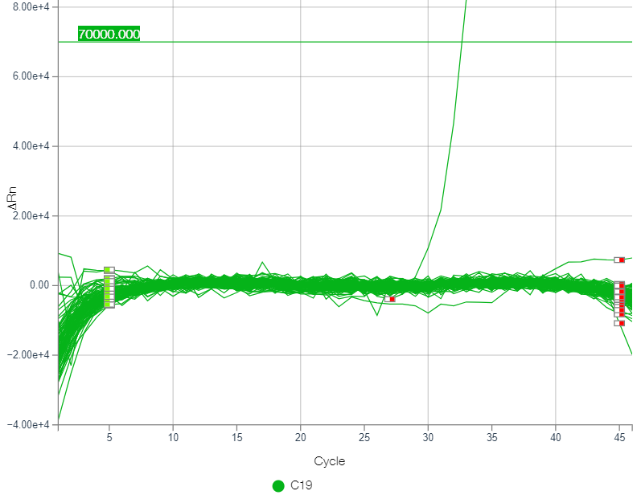
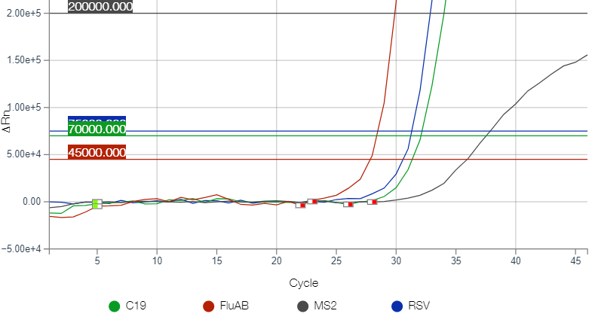
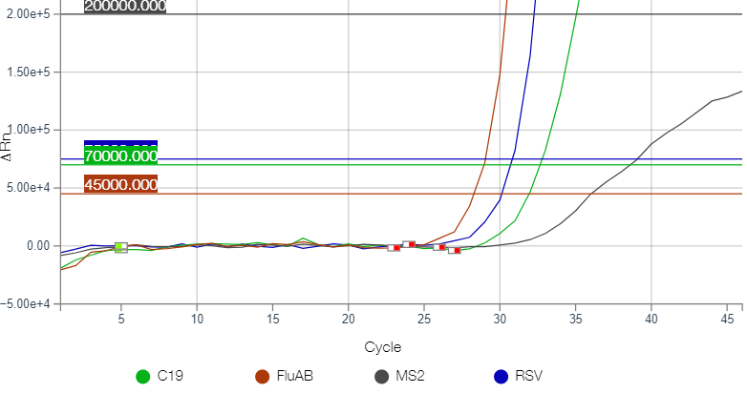
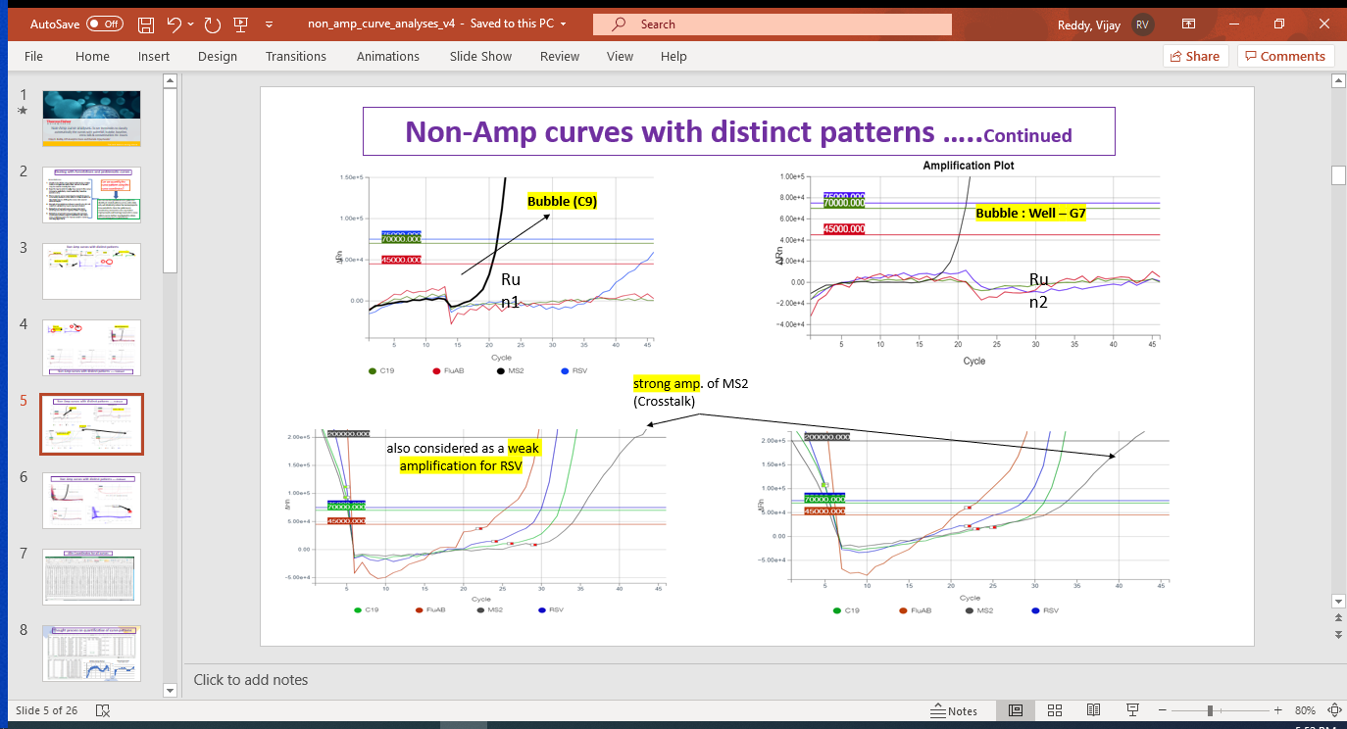
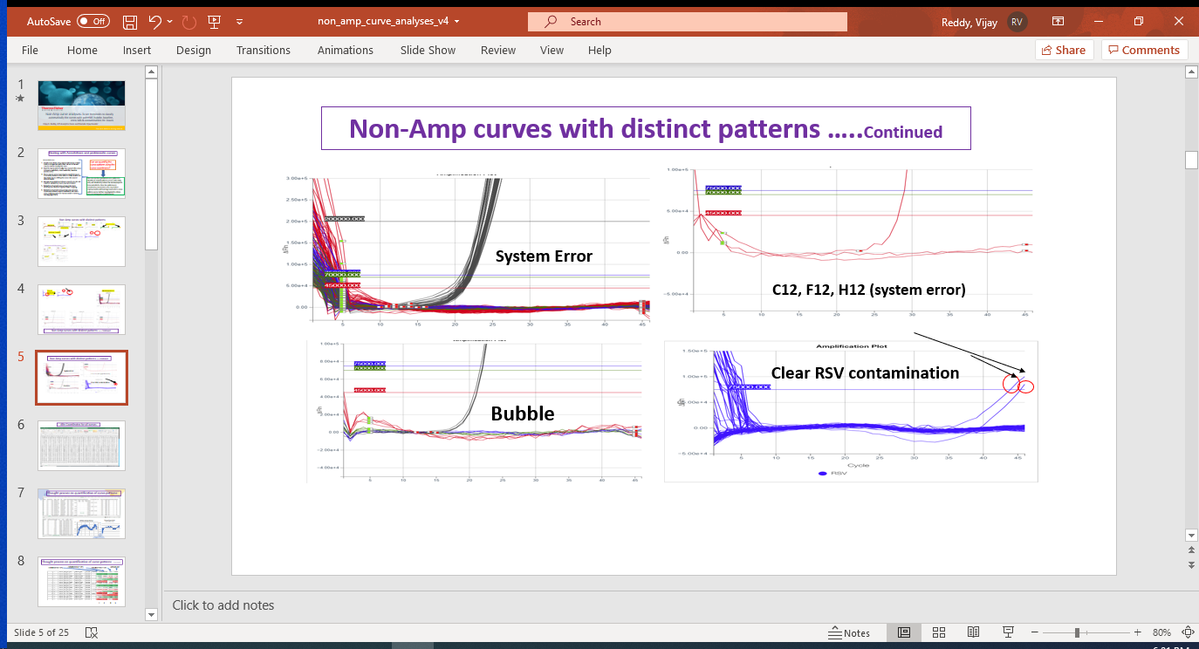
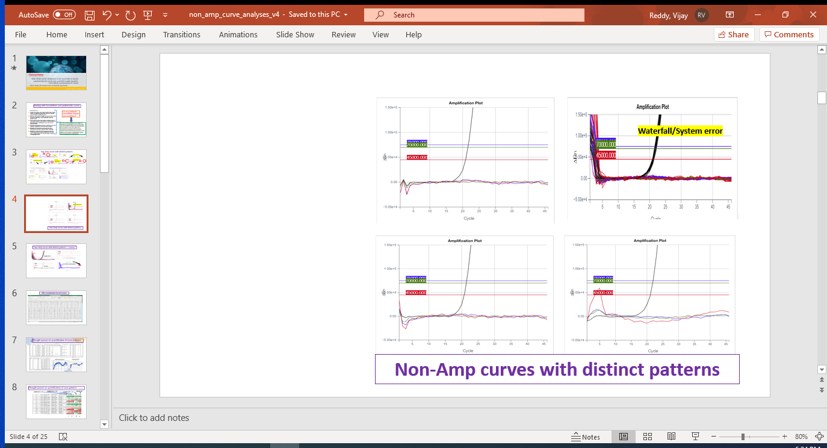
Non-Amp curves with distinct patterns
Clear RSV contamination at Well C1 C2 C3.
Bubble
Bubble
Weak C19 amp.
Baseline issue
Noisy Baseline
contamination at Well C1 C2 C3.
Weak amp. (Crosstalk)
Clear RSV contamination at Well C1 C2 C3.
Notes:
In the process of our report review I noticed several anomalous curves with appropriate names and explanations.
Sometimes we ourself involved in preparation of reports on our own using some of the automated scripts written by our offsite team in order to give a quick to R & D team.
As explained by experts the anomalous curves are labeled as clear, contaminated, bubble, weak Amp, baseline problem, water falls and revers water-falls, cross reactivity of dyes etc.
Presentations from experts have shown such problems.
Example of week Amps of different magnitude, base-line problem of several kind.

Slide 3
Objective of PatBaSe:
Problem Statement:
Lack of Quantitative Approach:
For curve annotation – current manual approach is very subjective, which leads to disparity of results between annotators
To determine presence of anomalous events like bubble(s), crosstalk etc. due to dye quenching or system errors
Proposed Solution:
An Automatic Classification Tool to categorize the curves into clusters using a quantitative method
A score-based computational mechanism to group curves exhibiting similar morphology
Identify presence of anomalous events like bubble(s), baseline probs etc. within a curve for automated annotation
Impact:
Improved efficiency and accuracy of annotation workflow
Can be made part of ML pipeline for automated curve annotation if needed
Target Audience:
Study Analysis Group
Annotation Team
ML Team (only if needed)

Slide 4
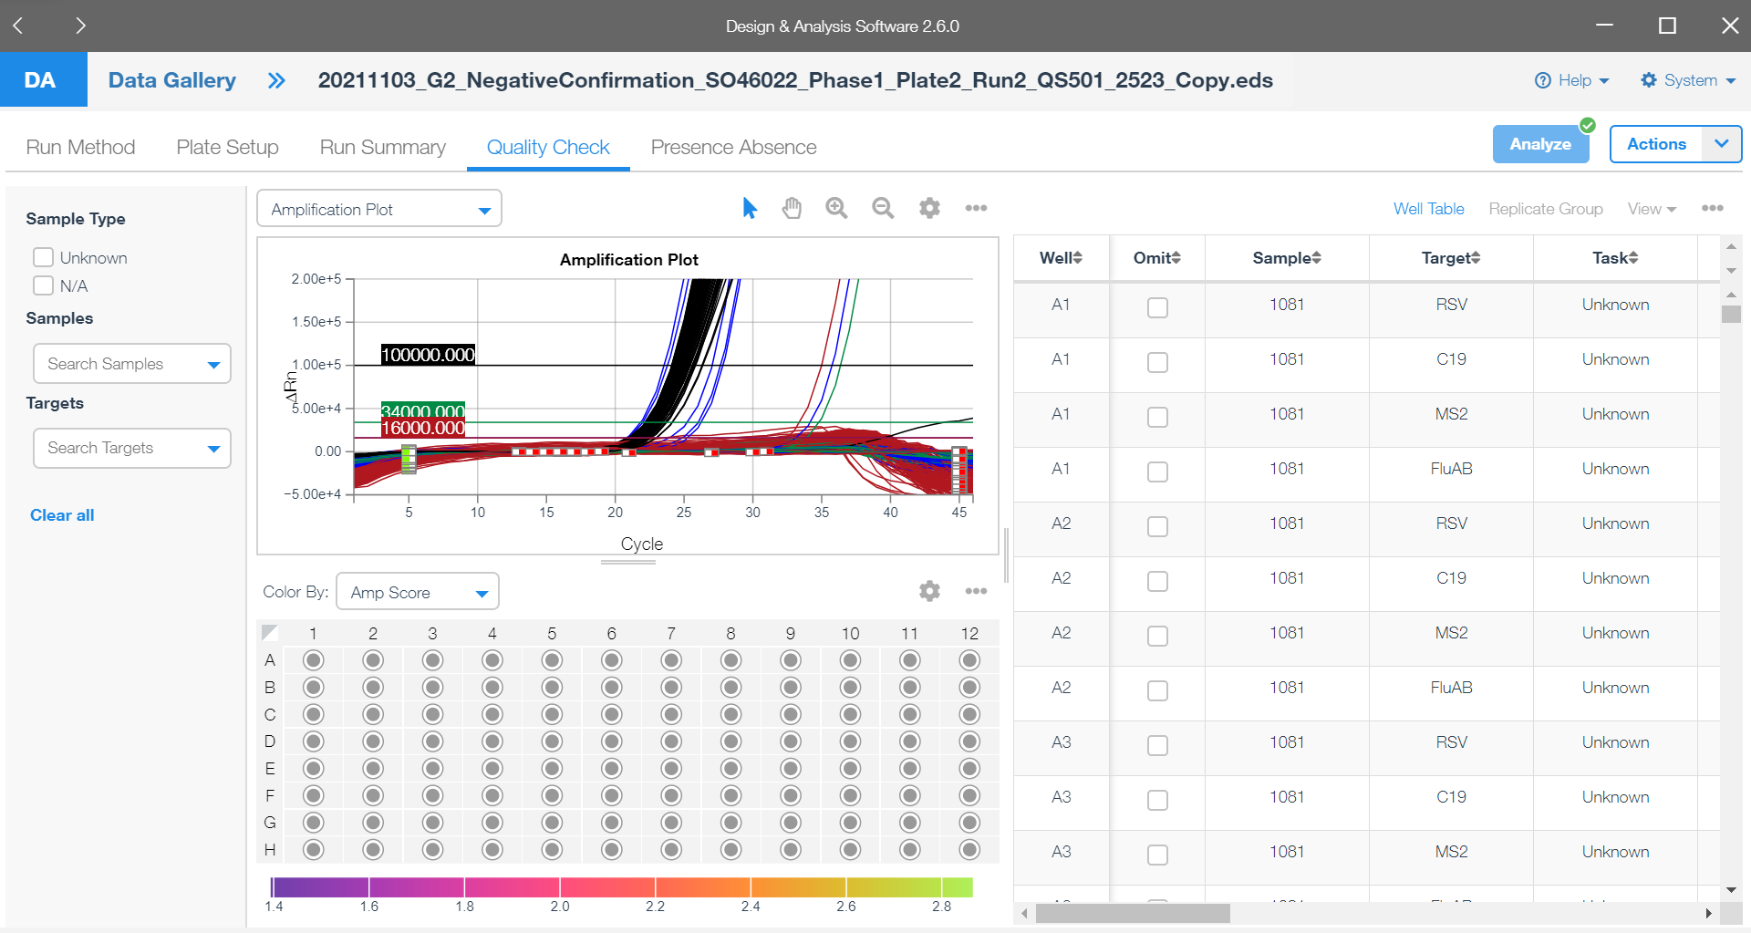







PatBaSe Tool
All Annotated Curve DB
Brief About the Tool:
A Command-line Utility
Intake:
Excel export of one or more analyzed eds files
Reference Anomaly curveDB
Output:
Excel with curve annotations
Outliers, Annotations Needed
EDS File
Reference (Anomaly) Curve DB
Excel Book
PatBaSe
Manual Annotations
Performance Matrix:
Provide some stats based on the DDD 73 data set.
Provide used case states on identified & novel curves from new EDS files.
Automated annotations in CSV
Annotations
Needed

Slide 5
Analysis of selected curve Database
Analysis to create reference curve data set
Analysis to test and improve the performance
Evaluating clustering by changing Reference curve within each cluster, helps to identify acceptable best reference Curve database(ERC)
Calibrating similarity Weight Matrices and determining right weight matrix to be used with final tool (CWM)
Performance Evaluations for different Anomalous curves: Bubbles, Baseline problem, Rooster-Tail, System Issue and Waterfall (PEA)
Putting together as usable tool for Annotation study groups and automated annotation Pipeline (PAP)
Miscellaneous Work, code review and Deployment etc. (MWD)
Quantify the Curve morphology into Pattern (QCP)
Similarity scoring Weight Matrix determination (SWM)
Comparative Scoring to identify similar curve Morphology (CSM)
Clustering of Curves at different % Similarity (60%, 70%, 80%, 90%) for variability evaluation. (CCS)
Obtain Representative from each Cluster after deciding the right % Similarity (RCS)
Create a Reference Curve Database for PatBaSe tool to compare and annotate new data set (RCD)

Slide 6
Milestone Plan & Weekly Status
 | Week | Week2 | Week3 | Week4 11/12 | Week5 11/19 | Week6 11/26 | Week7 12/03 | Week8 12/10 | Week9 12/17
1. QCP
2. SWM
3. CSM
4. CCS
5. RCS
6. RCD
7. REC
8. CWM
9. PEA
10. PAP
11. MWD

Slide 7
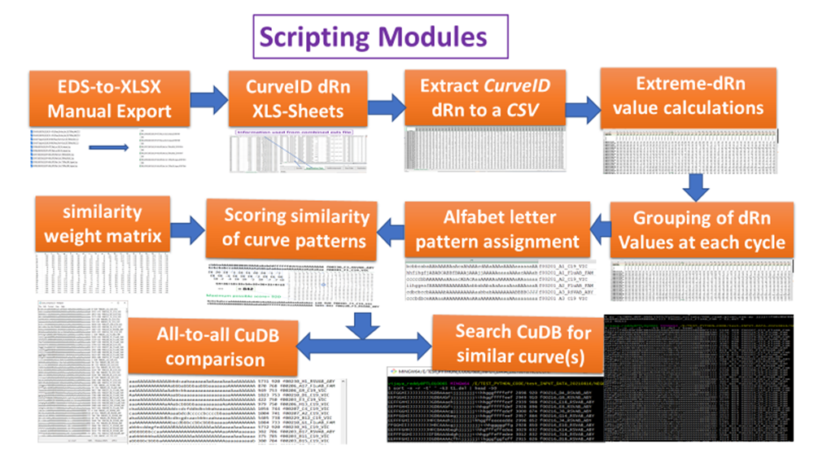

Slide 8
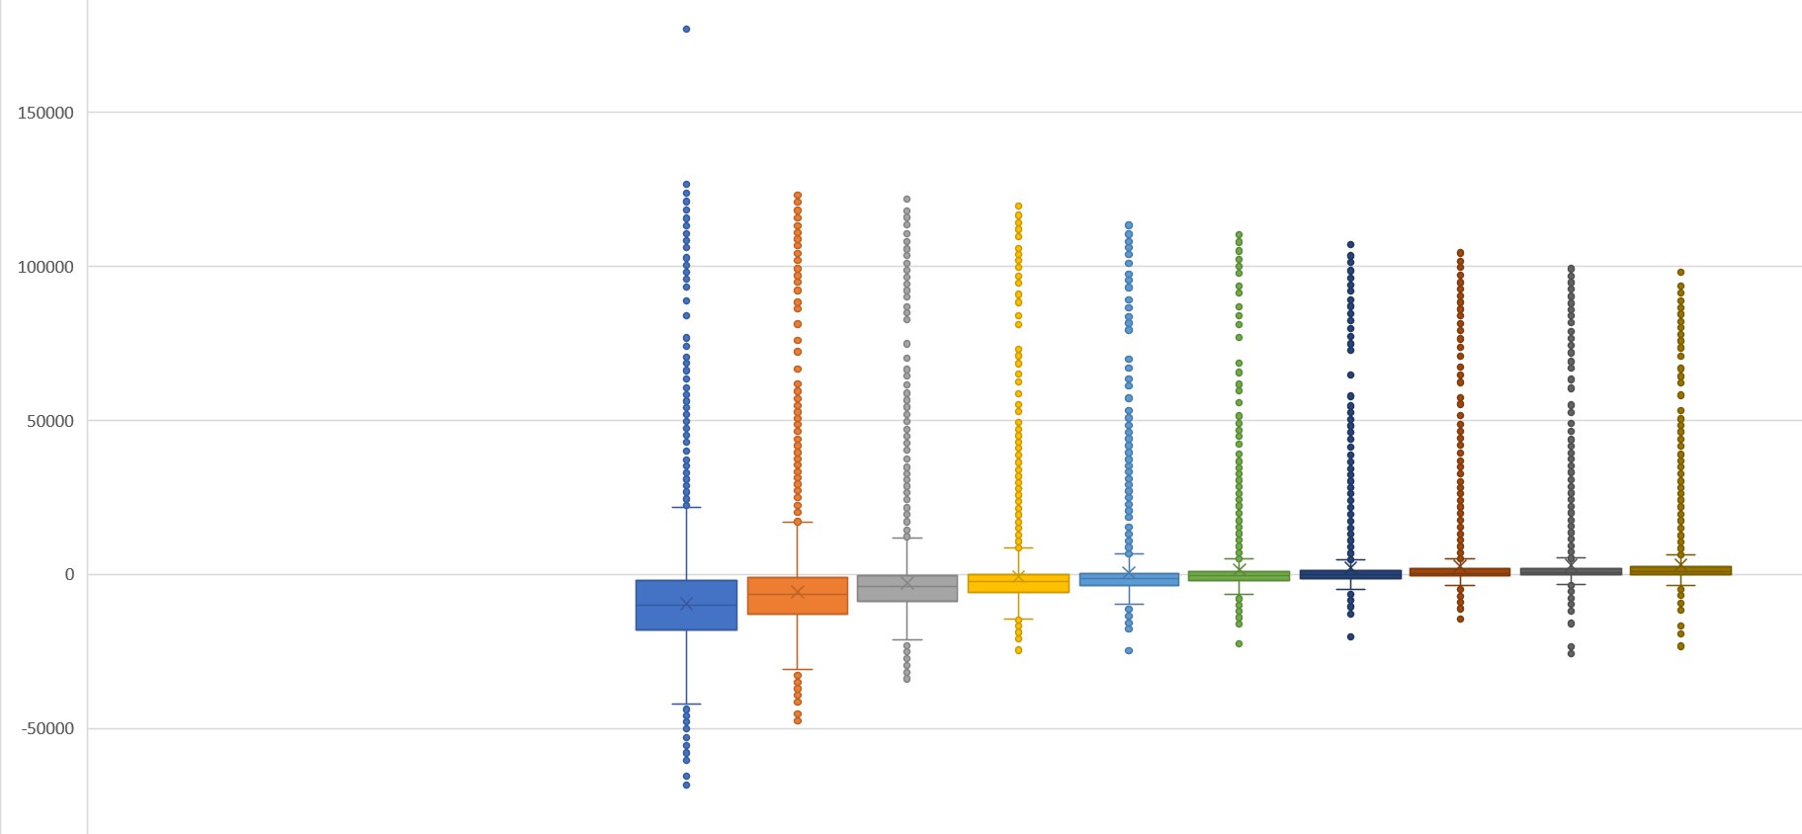
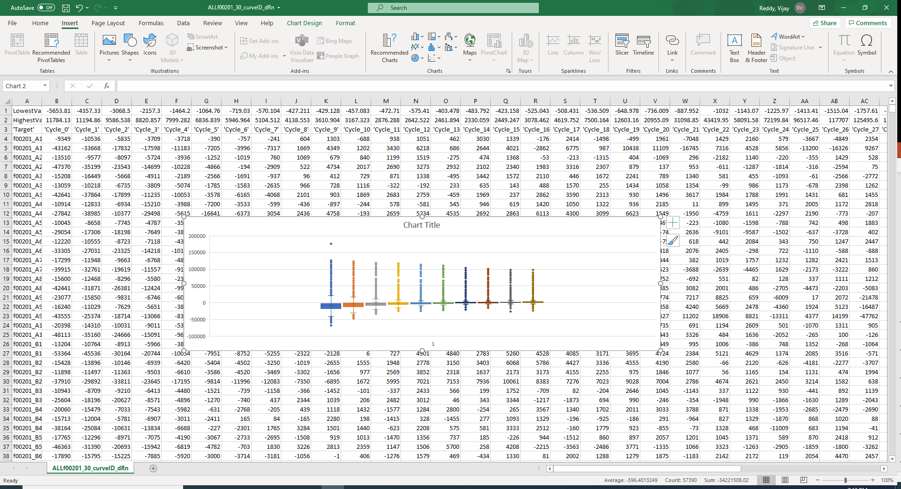
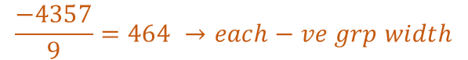
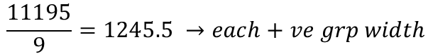
Extreme Value Calculation's and Grouping of dRn values
Distribution of dRn values in each of 10 Cycle
+ve Side Extreme Values
J
I
H
G
F
E
D
C
B
A
Mean
Top 10%
J
I
H
G
F
E
D
C
B
A
$$\frac{11195}{9}=1245.5 →each+ve grp width$$
a
b
c
d
e
f
g
h
i
j
a
b
c
d
e
f
g
h
i
j
Demo of Grouping Cycle-1
$$\frac{−4357}{9}=464 →each−ve grp width$$
Mean Bottom 10%
-ve Side Extreme Values

Slide 9
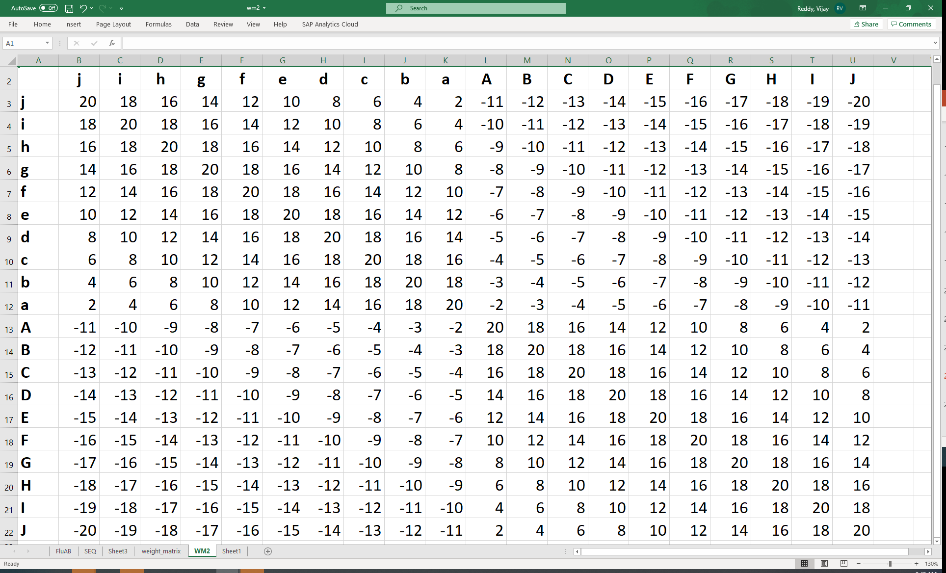
Scoring similarity of curve patterns
cbbbaAAAABBBBBBCBAAAaAabddffffffddcbaaAAAAAAAA f00230_F3_RSVAB_ABY
bcbcbabccaAAAAAAAaAabAbaAaAAaaaAAAaAAaaAaAaAaa f00201_F1_C19_VIC
18 18 18 -3 18 16 20 20 -5 -7
18 18 -4 18 18 18 -2 18 16 10
20 -2 -4 18 18 -2 18 -7 -7 10
54+36+10+33+54+32+36+31+4+13
= 842
+++
Maximum possible score= 920
bcbcbabccaAAAAAAAaAabAbaAaAAaaaAAAaAAaaAaAaAaa 138 920 f00201_F1_C19_VIC
cbbbaAAAABBBBBBCBAAAaAabddffffffddcbaaAAAAAAAA 5695 842 f00230_F3_RSVAB_ABY

Slide 10
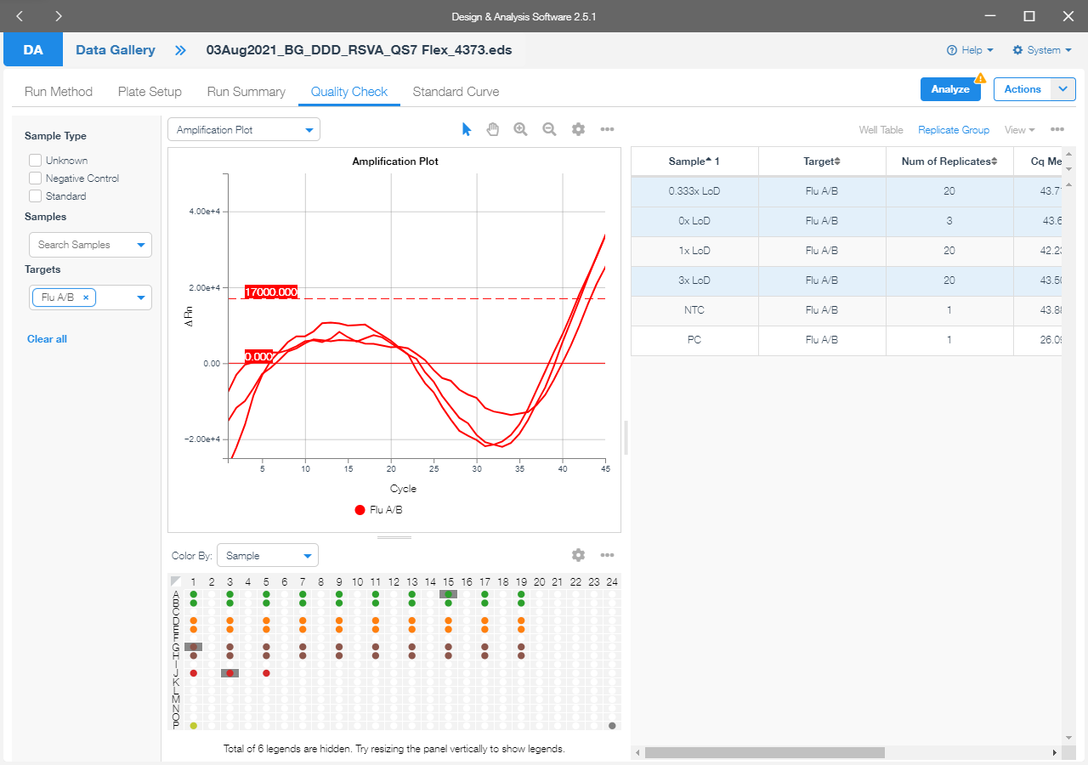
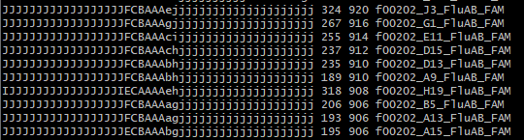
TESTS & RESULTS
Pattern-based identification of similar curves

Slide 11
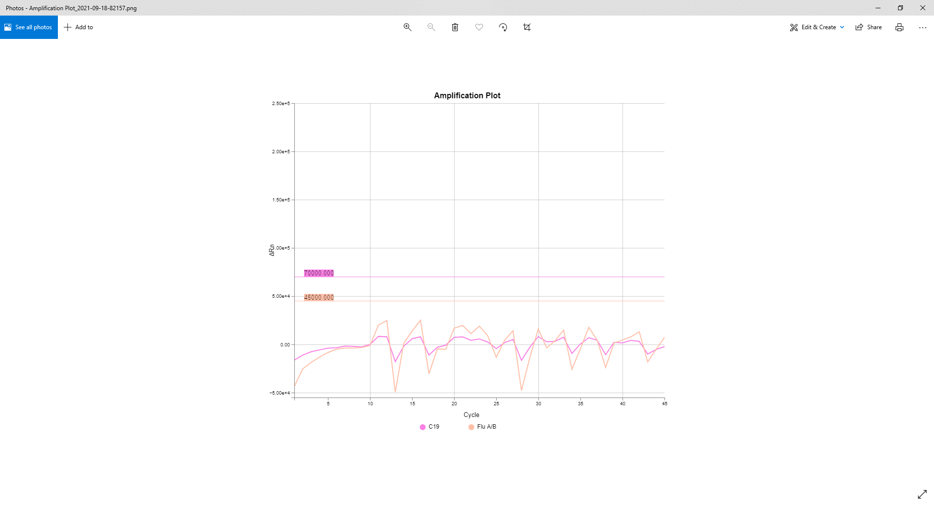
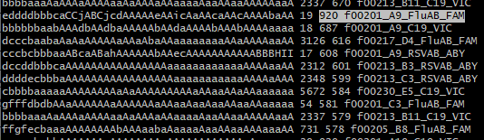
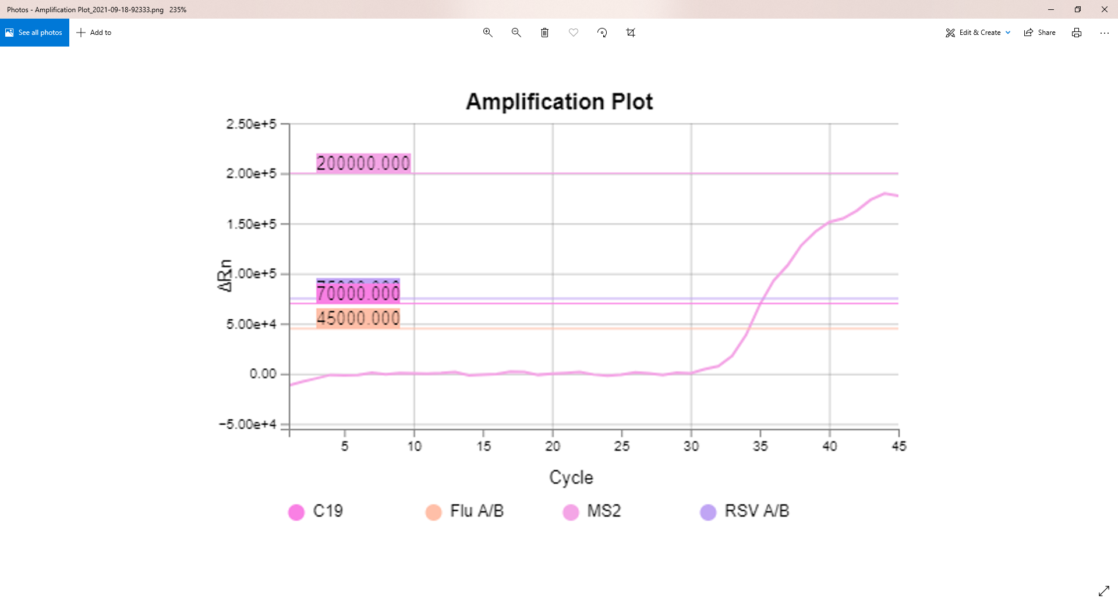
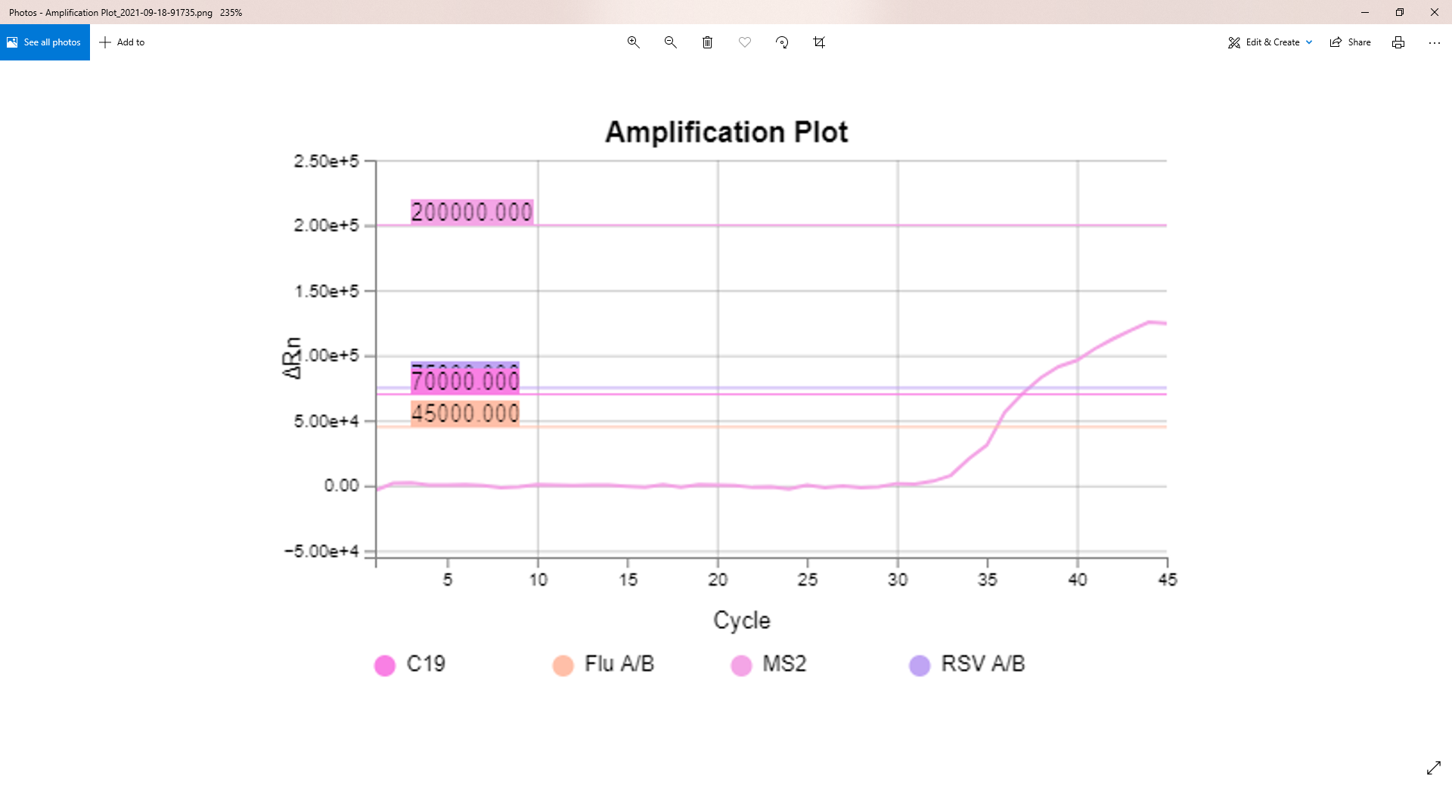
AaAaAAaaAAaAaAaaaAaAAAAAAAAABCEGIJJJJJJJJJJbaa 4815 920 f00225_H12_MS2_JUN
AAAaAaaaAaaaaaAAaaAaAAAAAAAAABCEGHHHHIIIIIIaaa 4441 654 f00223_H12_MS2_JUN
Pattern-based identification of similar curves

Slide 12
Clustering of Anomalous Curves into Groups
Clustering of curves based on their % of similarity to a reference curve
1903 independent clusters, at 70% similarity including the 1126 unique member clusters appears to be good number of clusters for user cases.
The cluster similarity improved after applying positional weight matrix at 75% cluster similarit.

Slide 13
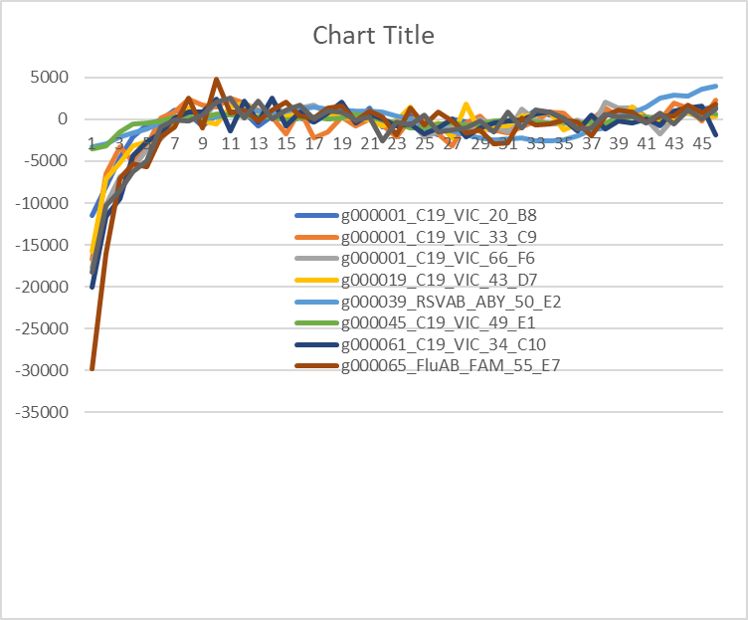
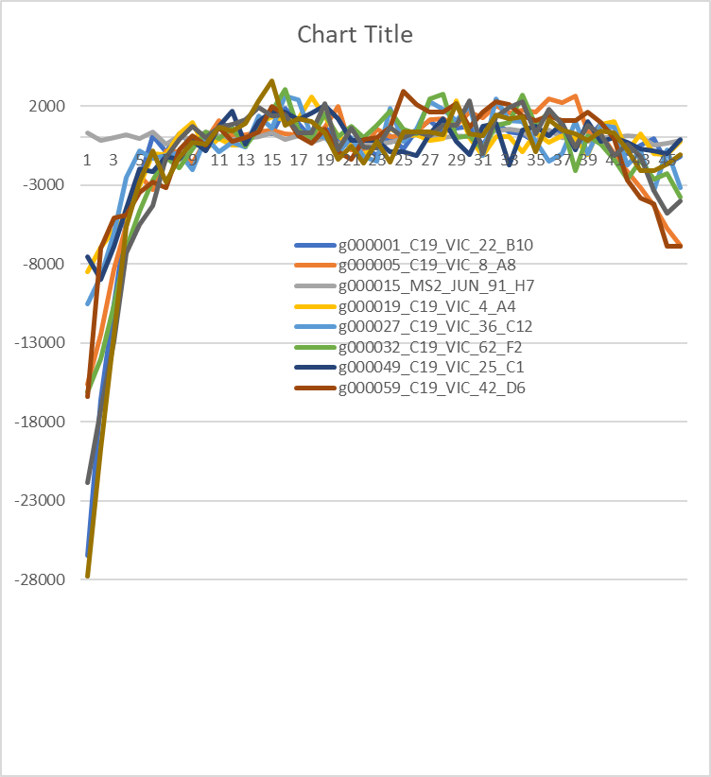
65% cluster groups

Slide 14
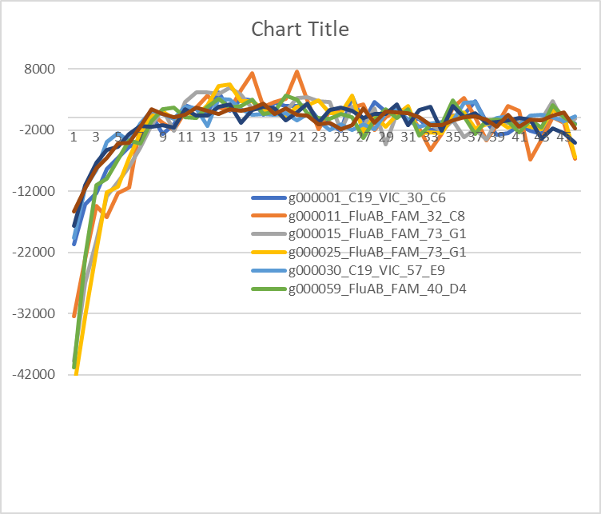
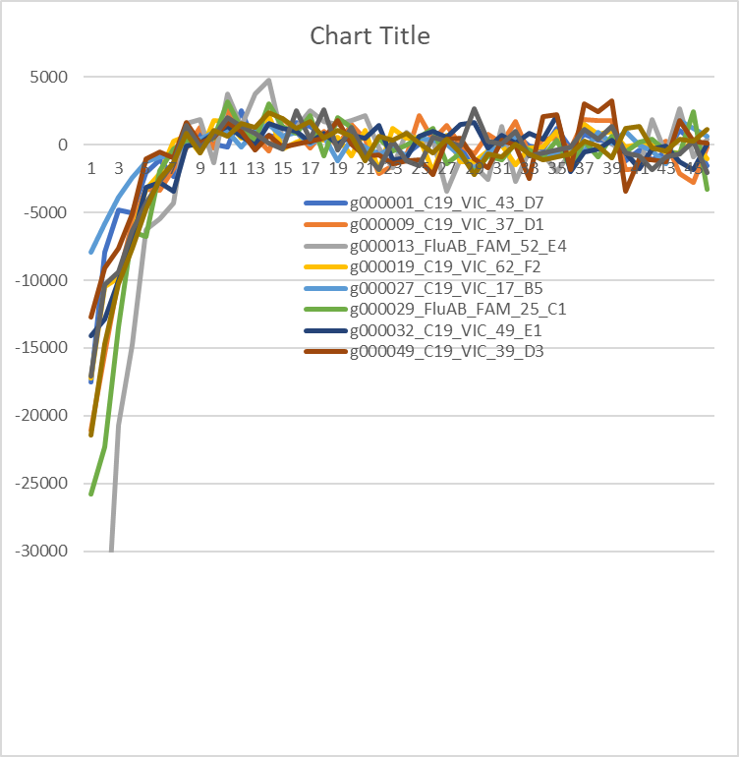
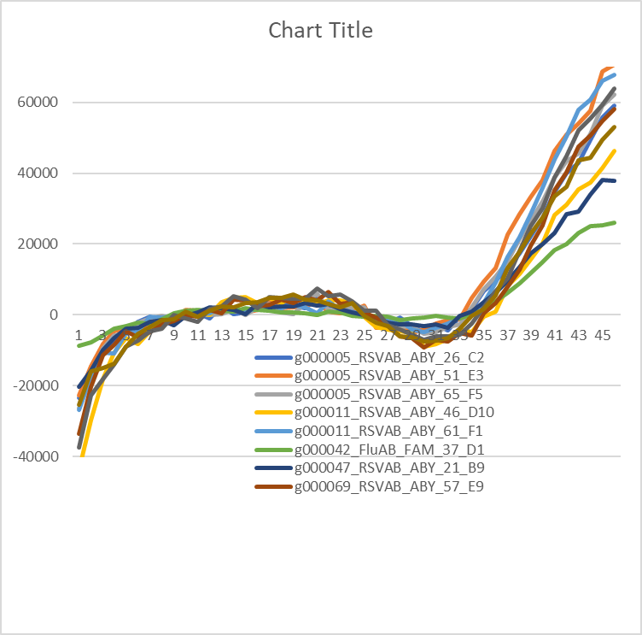
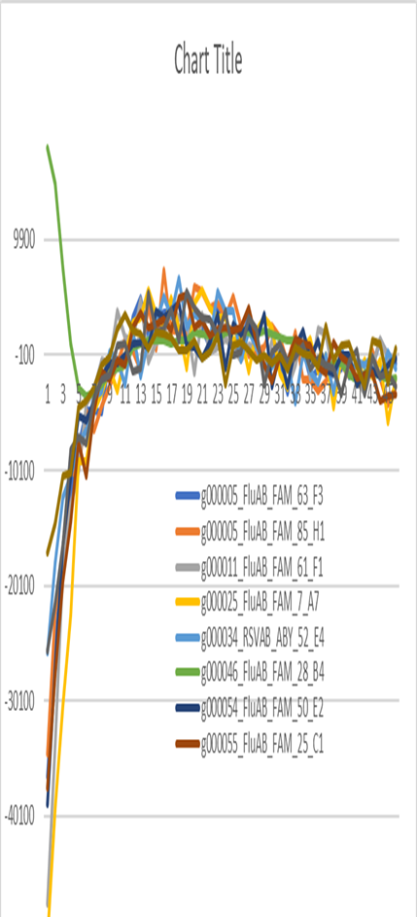
65% cluster groups

Slide 15
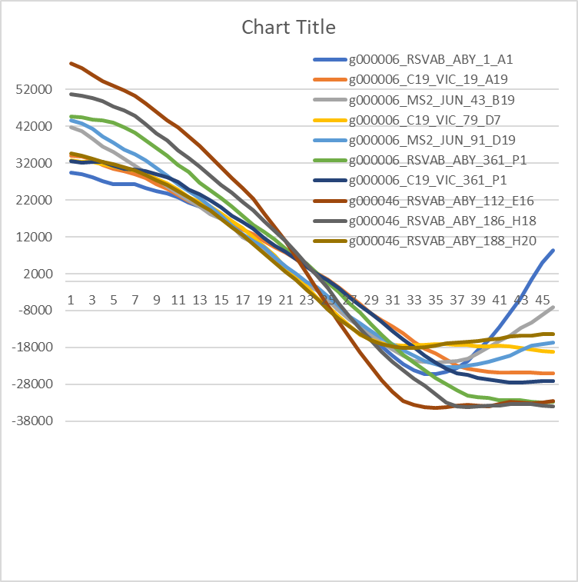
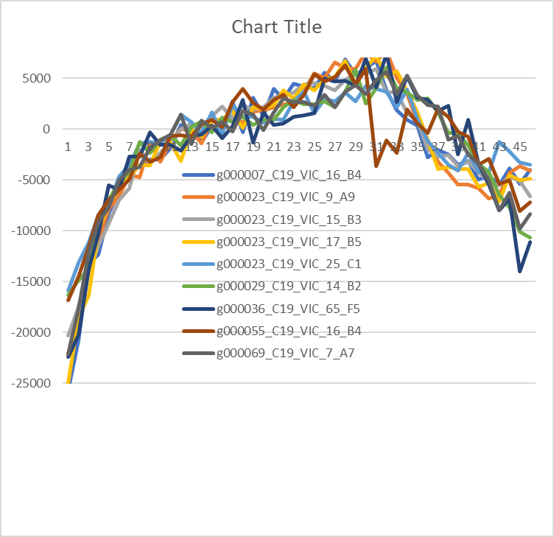
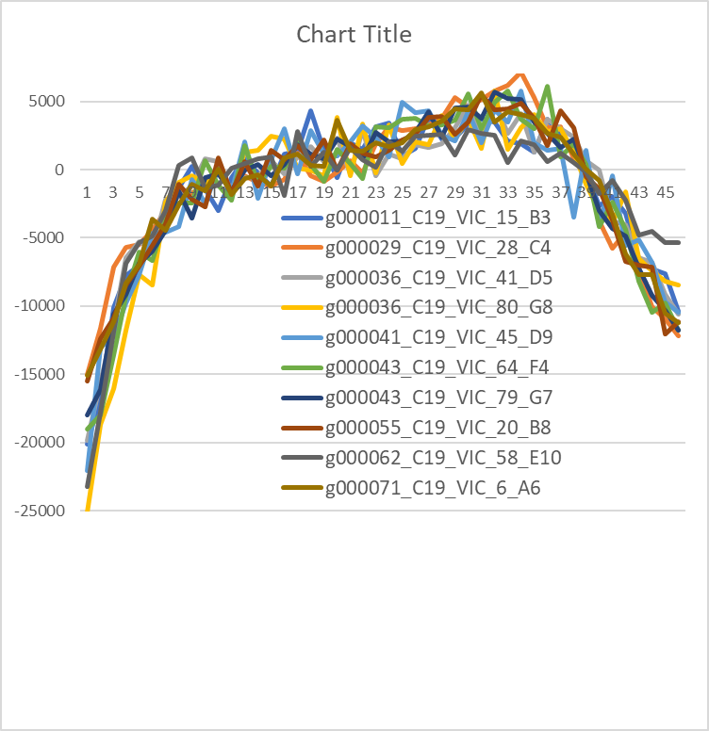
65% cluster groups

Slide 16
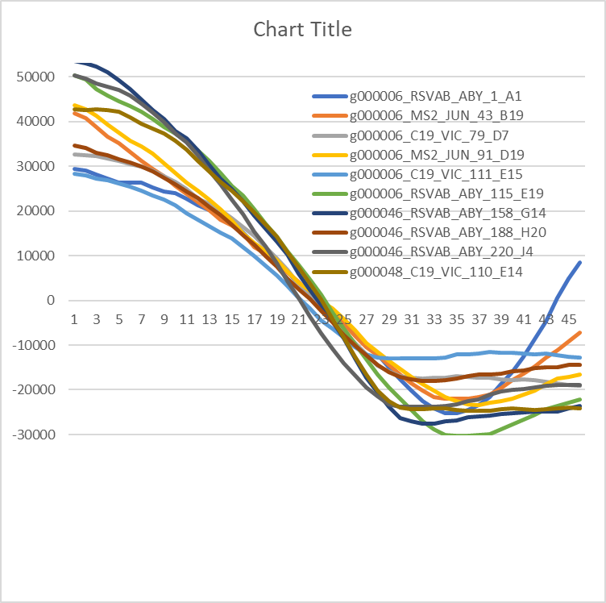
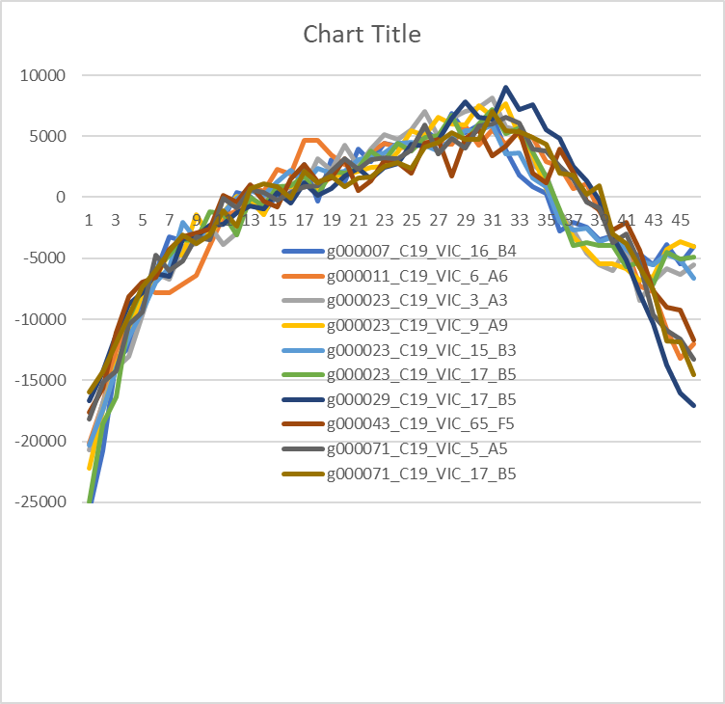
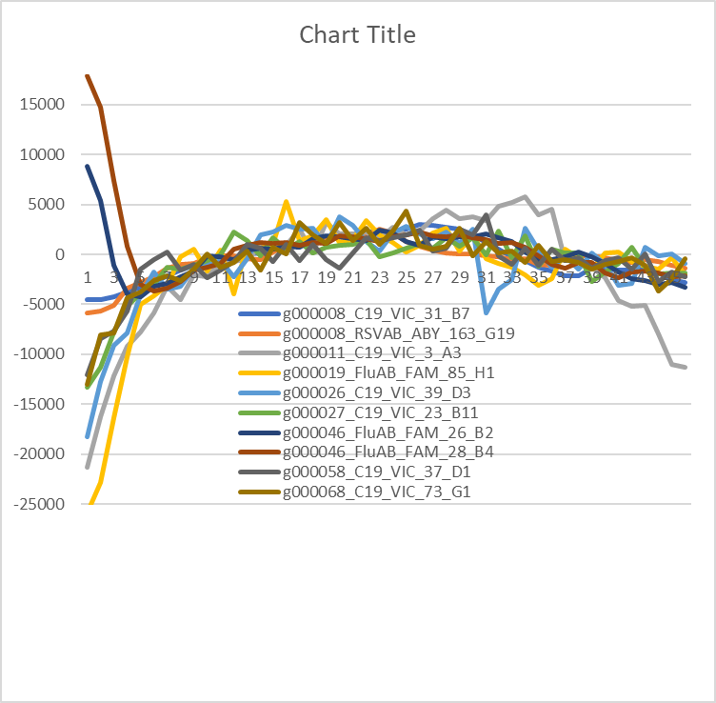
70% cluster groups

Slide 17
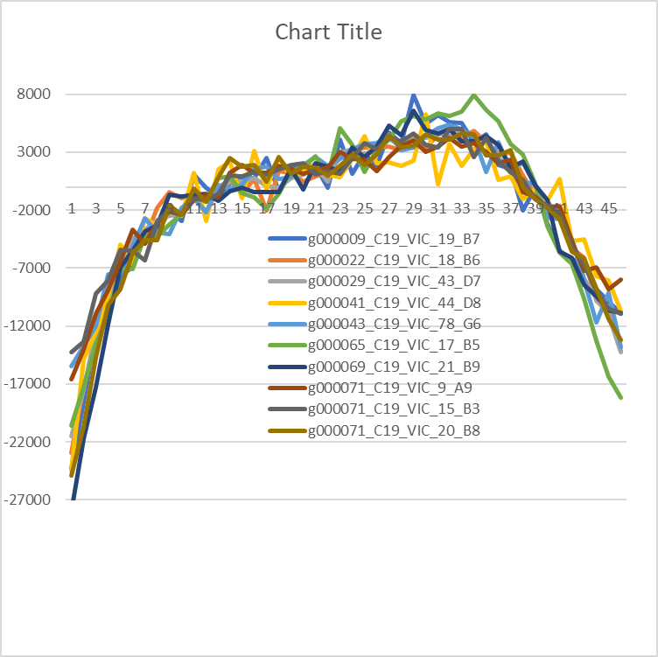
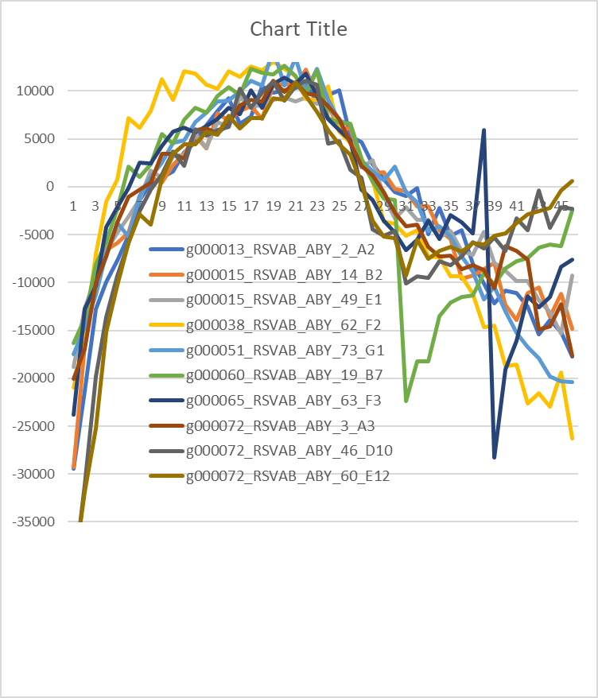
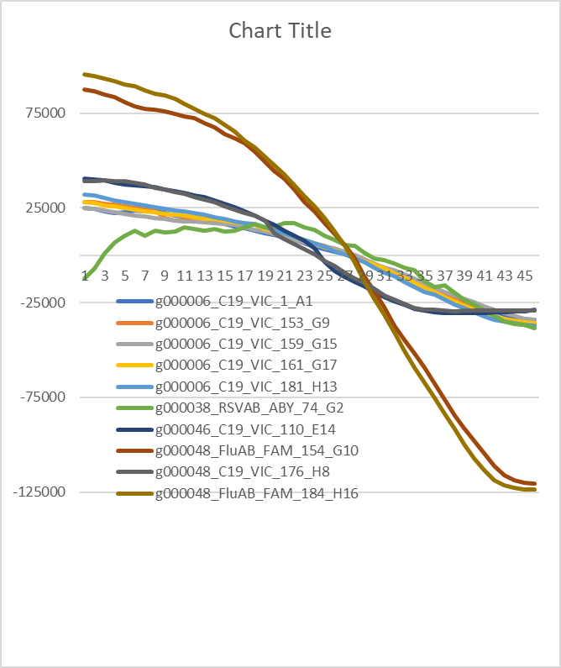
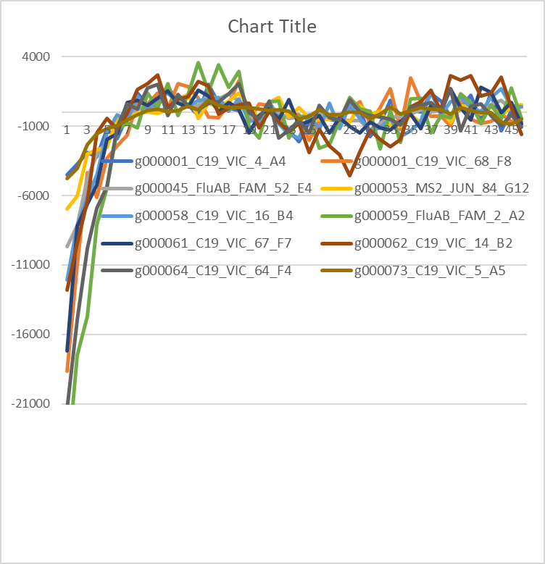
70% cluster groups

Slide 18
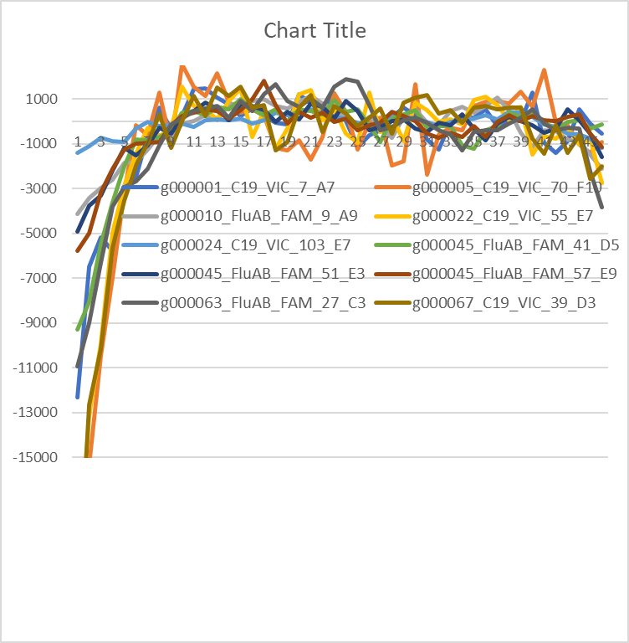
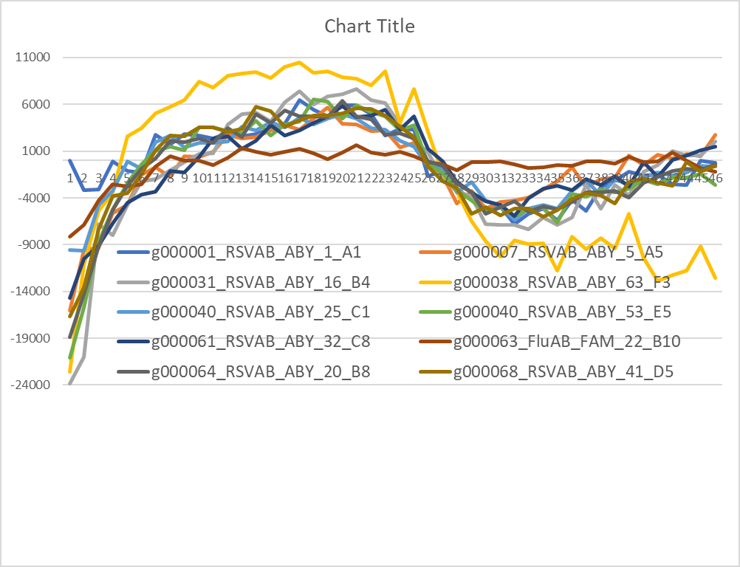
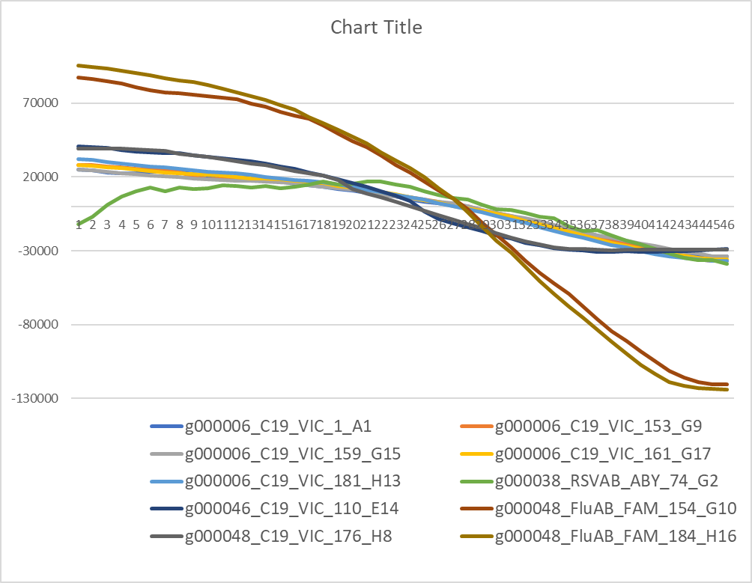
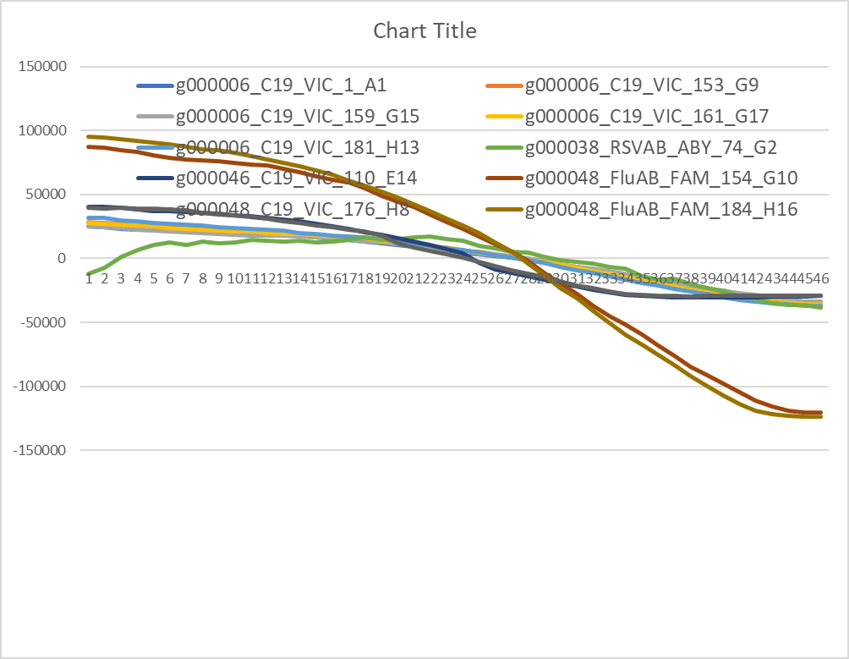
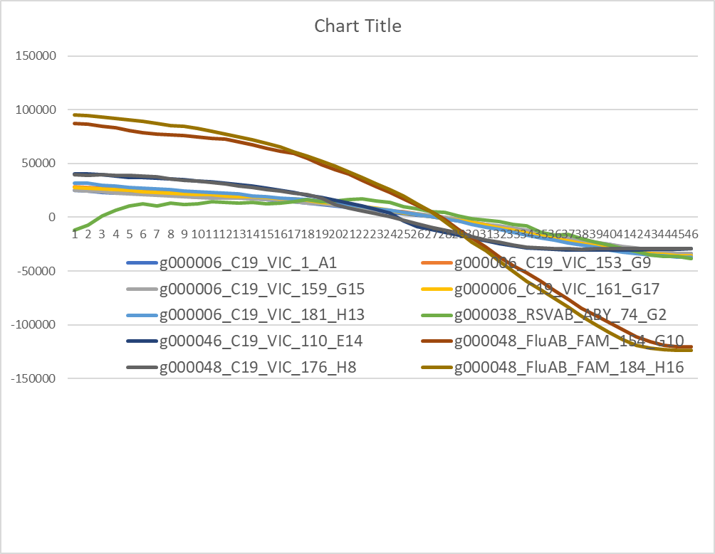
70% cluster groups

Slide 19
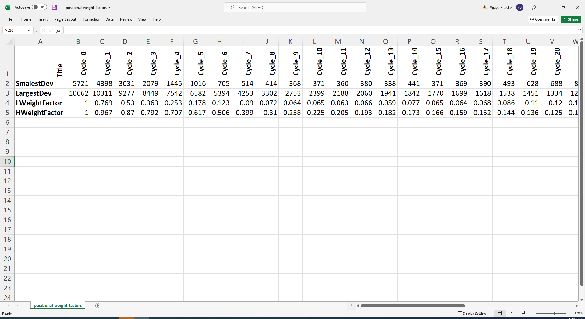
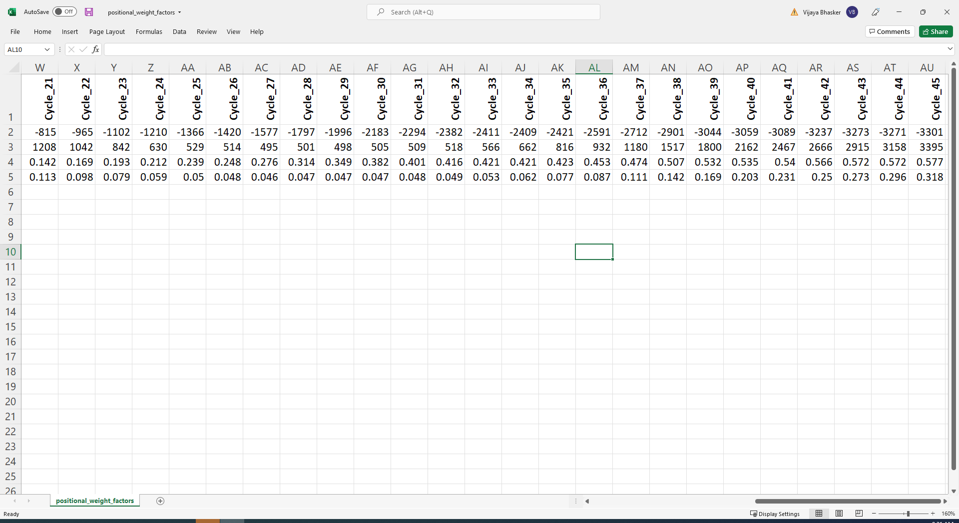
Position based weighting scheme (Non-Amp Curves)

Slide 20
Improvement in cluster groups after using positional weights
 | Similarity Weight Matrix Based Results |  |  |  |  |  |  | Similarity and Positional Weight Matrix-based Results
Cluster | No of Clusters (12087 curves) |  |  |  |  |  |  | No of Clusters (12087 curves)
Members | 60% | 65% | 70% | 75% | 80% | 90% |  | 60% | 65% | 70% | 75% | 80% | 90%
1 | 146 | 412 | 1127 | 2325 | 3220 | 7972 |  | 39 | 90 | 267 | 883 | 1776 | 5980
2 | 85 | 172 | 326 | 472 | 386 | 363 |  | 20 | 55 | 108 | 232 | 413 | 427
3 | 39 | 90 | 143 | 158 | 113 | 138 |  | 13 | 15 | 65 | 106 | 174 | 147
4 | 31 | 52 | 72 | 90 | 67 | 66 |  | 6 | 16 | 26 | 69 | 75 | 83
5 | 11 | 27 | 46 | 44 | 42 | 46 |  | 4 | 16 | 17 | 34 | 49 | 50
6 | 11 | 24 | 24 | 30 | 32 | 27 |  | 6 | 3 | 17 | 20 | 30 | 25
7 | 6 | 13 | 13 | 21 | 15 | 20 |  | 2 | 8 | 10 | 26 | 19 | 28
8 | 10 | 11 | 24 | 14 | 13 | 14 |  | 0 | 1 | 6 | 11 | 15 | 16
9 | 6 | 5 | 9 | 13 | 13 | 13 |  | 2 | 1 | 2 | 10 | 10 | 14
10 | 5 | 7 | 10 | 10 | 7 | 7 |  | 2 | 5 | 8 | 8 | 13 | 8
>10 | 73 | 401 | 117 | 98 | 97 | 69 |  | 42 | 63 | 101 | 120 | 118 | 97
Total Groups | 423 | 1214 | 1911 | 3275 | 4005 | 8735 |  | 136 | 273 | 627 | 1519 | 2718 | 6875
>10 curve clusters | 9706 | 9440 | 8725 | 7527 | 6632 | 1880 |  | 11837 | 11557 | 10902 | 9416 | 7749 | 3550
Highest Members | 2204 | 1515 | 1185 | 878 | 531 | 136 |  |  |  |  |  | 634 | 249

Slide 21
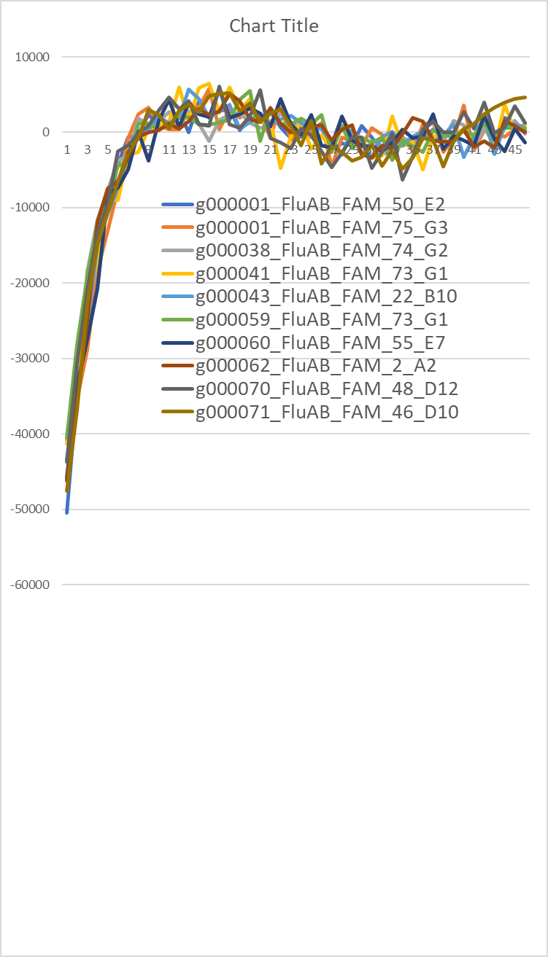





Positional Weights applied at 75% Cluster Groups

Slide 22






80% Similarity curves

Slide 23



3 groups of 10 Uniq member clusters (unrelated at 80%)

Slide 24
PatBaSe Tool
All Annotated Curve DB
Working on final part of the tool
To accept new eds output
To compare with reference set of
annotations
Automatically annotate the new
related curves.
Report the automated annotations
one side
Report the unrelated curves back
to the for manual annotation
EDS File
Reference (Anomaly) Curve DB
Excel Book
PatBaSe
Manual Annotations
Automated annotations in CSV
Annotations
Needed

